Slide 1
Indian food Classification

Slide 2
With all Food Ingredients Predicted the Diet of the Food Veg/Non-veg using Neural Networks

Slide 3
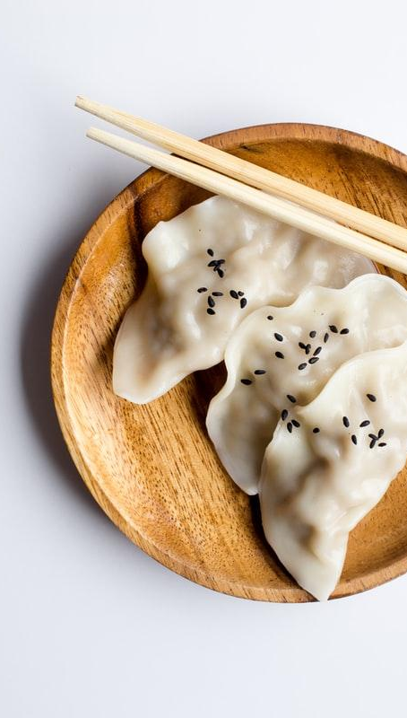
BACKGROUND
Imported the Data Set.
Removing the unwanted Columns.
Created a separate data-frame for ingredients.
Done One Hot Encoding.
Rearranging the columns.
Done Train and Test Split.

Slide 4
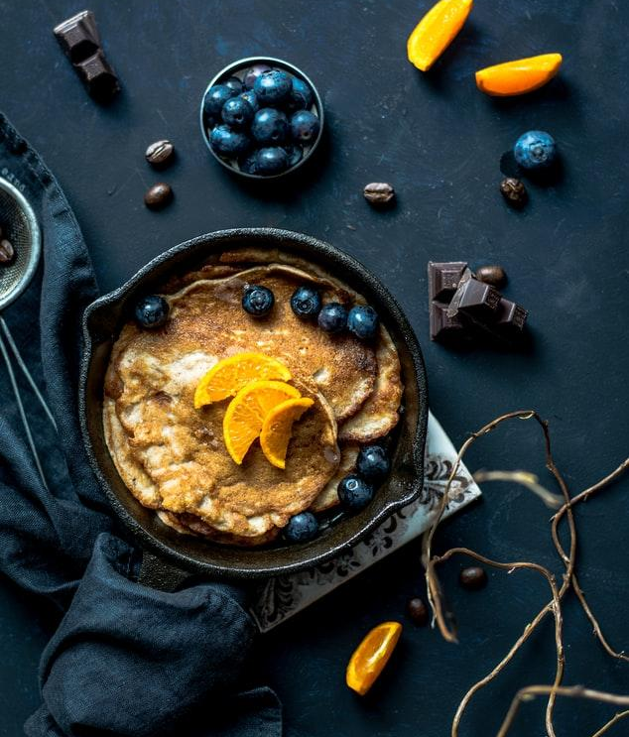
What You did?
Model is Build using Neural Networks
Trained the neural network with food ingredients
Predicted the diet veg/non-veg

Slide 5
Metrics
Accuracy
AUC
Two metrics used here we got
85%
83%

Slide 6
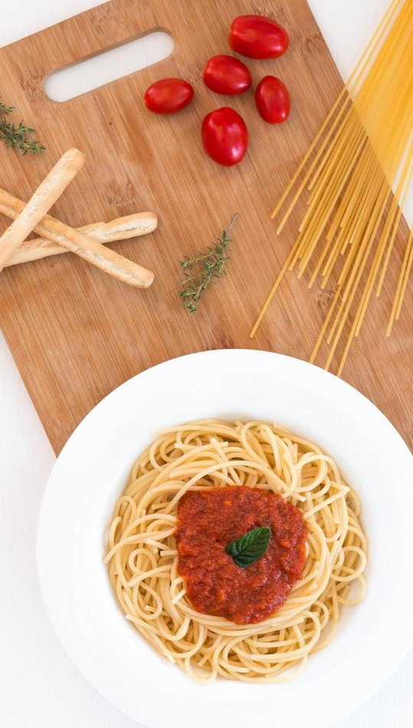
Conclusion
Model Building using Neural Networks.
Data passed into the model
Prediction is done with the ingredients

Slide 7
THANK YOU
2
Done by
D i v a k a r

